Slide 1
Phishing Website Decision Tree
Jaken Whipp

Slide 2
AGENDA
Introduction
Brief Literature Review
Methodology, Results and Discussion
Conclusion

Slide 3

What is Phishing?
Phishing is a type of cyberattack in which attackers mimic legitimate organizations in order to obtain personal information from their victims.
Not this.

Slide 4
Why Is Phishing Important?
Phishing attacks in 2021 produced a loss of $44,213,707 [1]
Phishing attacks are a growing issue
The amount of reported phishing attacks has increased 34 percent from 2020 to 2021 [1]

Slide 5
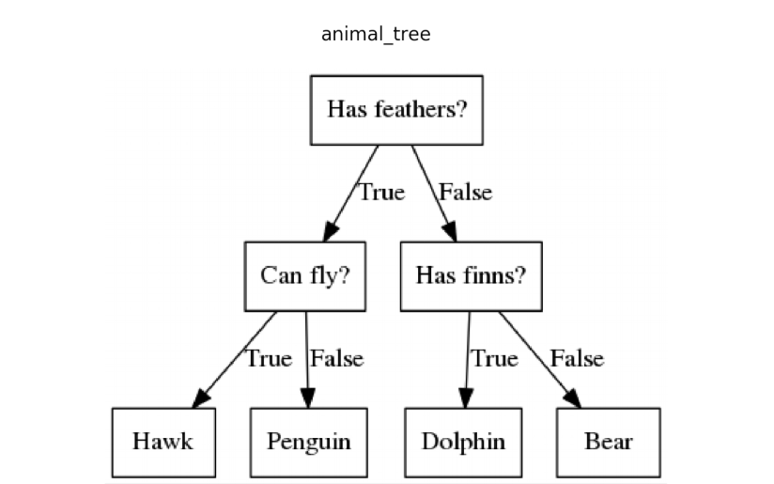
Decision Tree Model
A data mining technique which falls under classification models
A decision tree facilitates the classification of something based on passed parameters
Could a decision tree prove beneficial to the classification of phishing websites?
That is what I explored in this project

Slide 6
Literature Review
Very Brief

Slide 7
Two Studies investigated the same Dataset
One [5] used the Associative Classification (AC) method of Multi-label Classifier based Associate Classification. This approach detected phishing websites with great accuracy.
The other [6] used multilayer perceptron (MLP), a type of neural network. They found the MLP trained with Hybrid Salp Swarm Jaya was able to distinguish phishing websites.

Slide 8
Methodology, Results, And Discussion

Slide 9
The Data
Where?
What?
Values?
The data was obtained from the UCI Machine Learning Repository
The dataset contains information about 1353 websites and specific information about the sites.
One example attribute is Web Traffic.
The values of the attributes are stored as either -1, 0, or 1 with -1 representing phishing, 0 representing suspicious, and 1 representing legitimate.
Some attributes were exceptions to this (IP Address).

Slide 10
Important Libraries
The following libraries were vital to the investigation
Pandas
Sklearn
Scipy

Slide 11
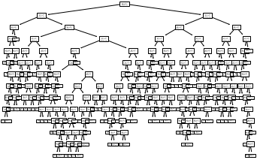
The Gini Index Decision Tree

Slide 12
Bottom

Slide 13
Experimental Results
The decision tree produced an accuracy of 86.94%.
Around 14% of the time the model would incorrectly classify a website

Slide 14
Possible Improvements
The removal of a third classification grouping as the suspicious classification provide more opportunity for incorrect classification
A larger dataset

Slide 15
THANK YOU

